Slide 1
Finding the best locations for Japanese restaurants in NYC
Capstone Project
The Battle of Neighborhoods (Week 2)

Slide 2
Business Situation
The objective of this Capstone project is to select the best locations in the city of New York to open a new Japanese restaurant.
Using Data Science methodology and instruments such as Data Analysis and Visualization, this project aims to provide solutions to answer the business question: Where in the city of New York, among all the boroughs and neighborhoods should the investor open a Japanese Restaurant?

Slide 3
Data
Data required
List of borough and neighborhoods of New York
Latitude and longitude coordinates of those neighborhoods
Venue data: likes, ratings, tips, etc.
Sources of data
Open source dataset of New York: https://cocl.us/new_york_dataset
Geocoder package for latitude and longitude coordinates
Foursquare API for venue data

Slide 4
Methodology
Collect the data from https://cocl.us/new_york_dataset
Clean and process the data into a dataframe
Use FourSquare API, locate all venues and then filter by Japanese restaurants
Ratings, tips, and likes by users will be counted and added to the dataframe
Sort the data based on likes, ratings, tips
Visualize the data using graphing from Python libraries

Slide 5
Results
There’re 306 different neighborhoods in NYC
Queens has the highest number of Neighborhoods:
Manhattan both have a high number of Japanese restaurants. Brooklyn has a high number as well.
Flatiron and Midtown South have the highest number of Japanese Restaurants with a total count of 4+4=8.
They are both in Manhattan.
the most liked restaurant is located in Midtown South, Manhattan; the highest-rated one is located in East village, Manhattan, and most tipped on is located in Chelsea Manhattan.
Manhattan probably has a good reputation for Japanese restaurants.

Slide 6
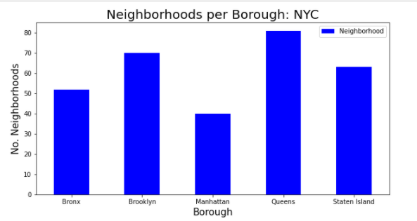
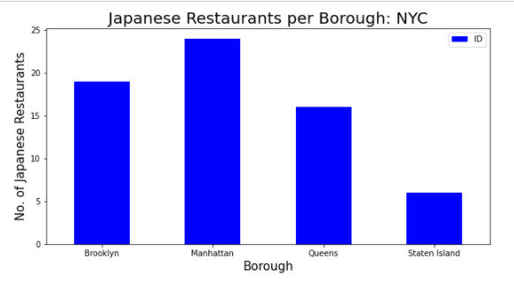
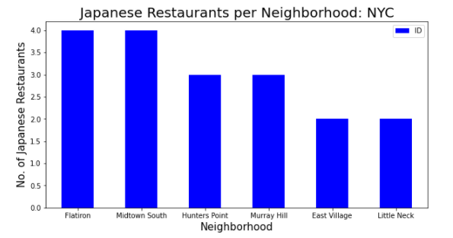
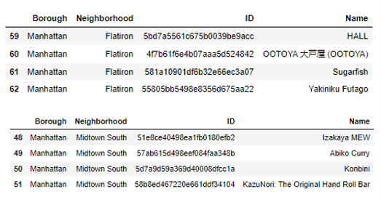

Slide 7
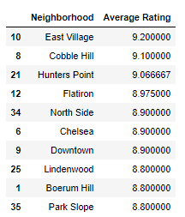
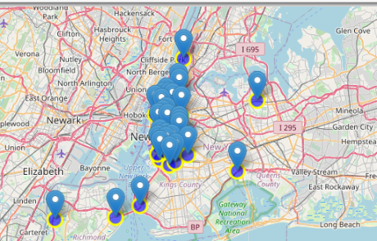
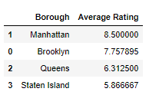

Slide 8
Discussion & Conclusion
Based on the results of our analysis, Manhattan and Brooklyn both could be a good location for Japanese cuisine in NYC
Manhattan is essentially more promising to open a new Japanese restaurant.
Brooklyn:
Fewer existing competitors
Good number of potential customers
Less overhead capital for a very high-end look.
Manhattan
Better Japanese reputation
Higher price charged, plus more tips and high turn-over rates

